Slide 1
PIZZA STORE
WIPRO CAPSTONE PROJECT
GREAT LEARNING
NAME : Asa Bhargava Lakshmi Narasimha
EMAIL : asabharga2004@gmail.com
PROJECT ID : Pizza Store
WIPRO NGA –MERN-FY26
MERN Stack Full-Stack E-Commerce Application

Slide 2
DESCRIPTION
Pizza Store is a full-stack MERN e-commerce application for ordering pizzas online. Customers can register, browse the menu by category, add items to cart, place orders (delivery/pickup), make payments, track orders in real-time, and receive order alert notifications. Admins can perform full menu CRUD, accept/reject orders, manage revenue analytics, and communicate with customers. Built with Node.js + Express backend, MongoDB (8 collections), React frontend with Redux, and JWT authentication.
MongoDB
Express.js
React.js
Node.js
Redux
JWT Auth
REST API

Slide 3
TECHNOLOGIES USED
Frontend (Client – React)
React.js – Component-based UI library for building the complete user interface
Redux – Centralized state management for auth tokens, cart state, and order data
React Router – Client-side routing between Menu, Cart, Orders, Admin pages
Axios – HTTP client for making REST API calls to the Node.js backend
JWT Authentication – Token stored client-side to maintain secure sessions
Context API (Auth Context) – Manages logged-in user info and role (Admin / Customer)

Slide 4
TECHNOLOGIES USED
Backend (Server – Node.js / Express)
Node.js + Express.js – RESTful API server with 8 route modules (auth, menu, cart, orders, payments, messages, categories, addresses)
MongoDB + Mongoose – NoSQL database with 8 collections; seed data populated via seed.js
JWT (JSON Web Token) – Authentication & role-based access control (Admin vs Customer)
bcryptjs – Password hashing for secure credential storage and login verification
Stripe / Payment Module – Handles payment processing linked to orders collection
Middleware – CORS, auth guards, error handling across all protected API routes

Slide 5
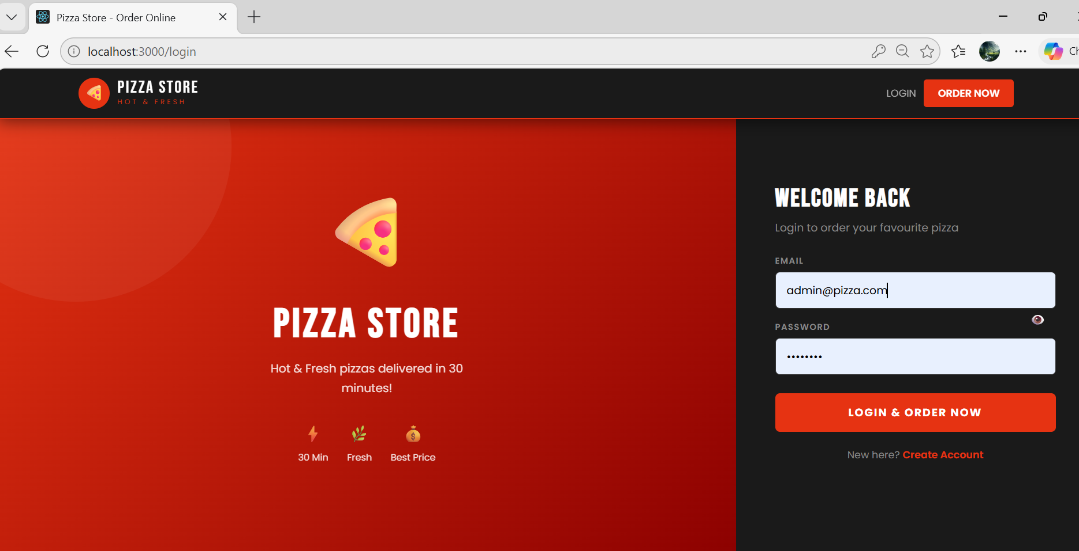
OVERVIEW OF APPLICATION
LOGIN PAGE :

Slide 6
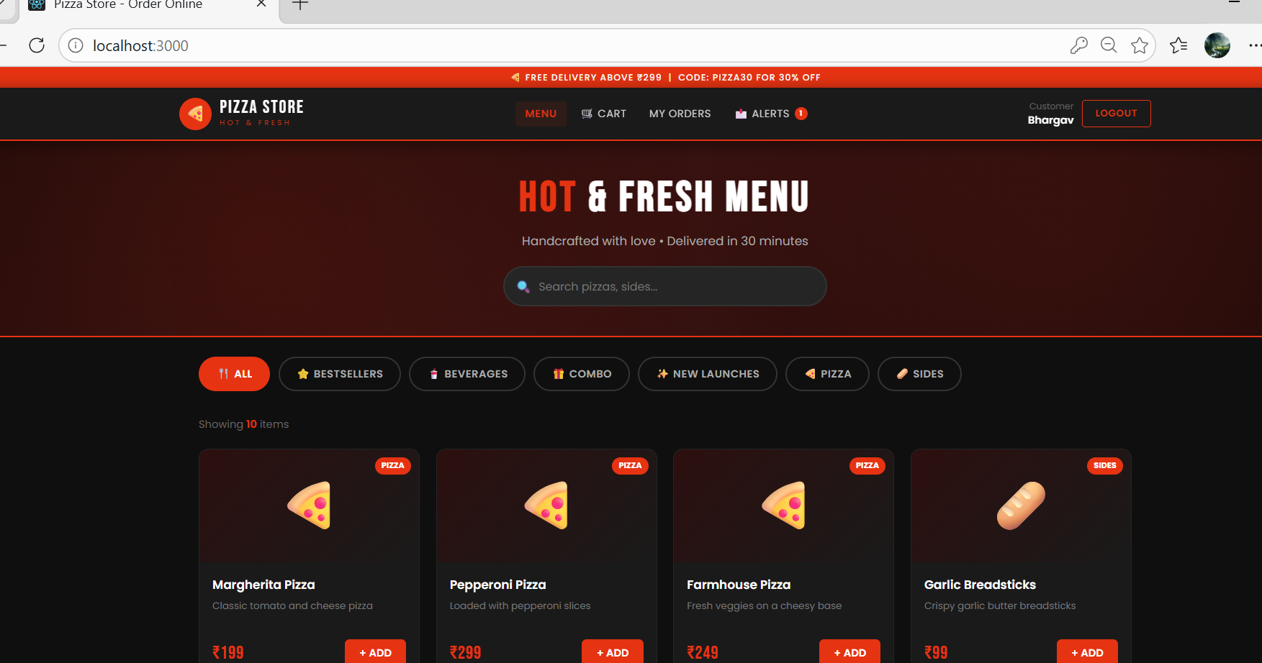
OVERVIEW OF APPLICATION
USER MENU PAGE :

Slide 7
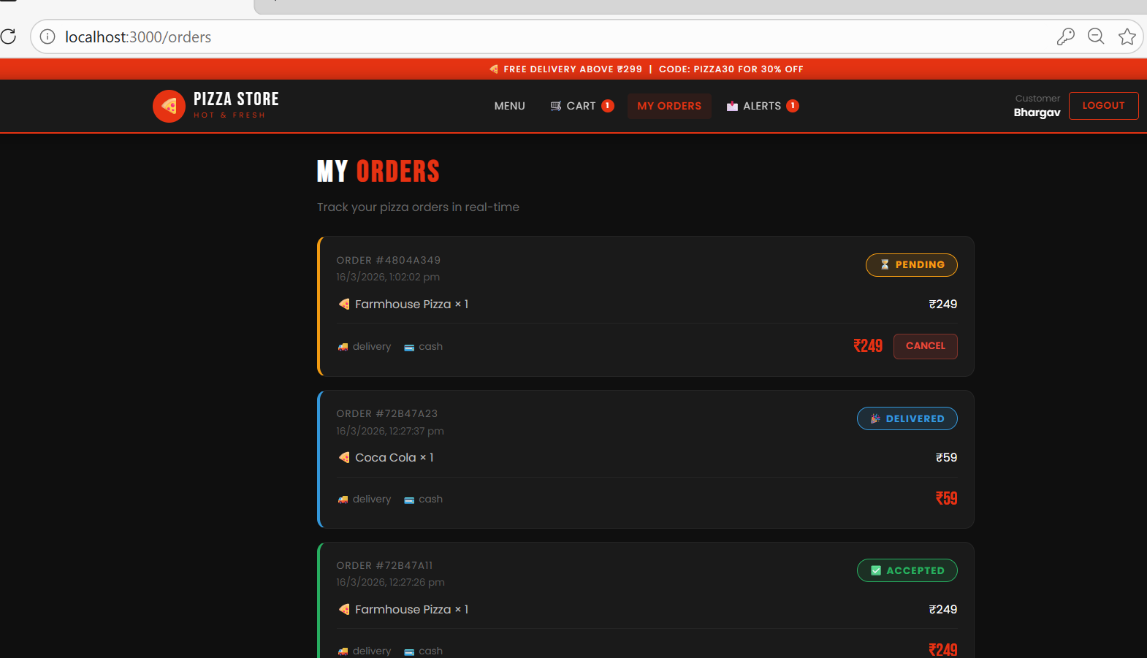
OVERVIEW OF APPLICATION
USER ORDER PAGE :

Slide 8
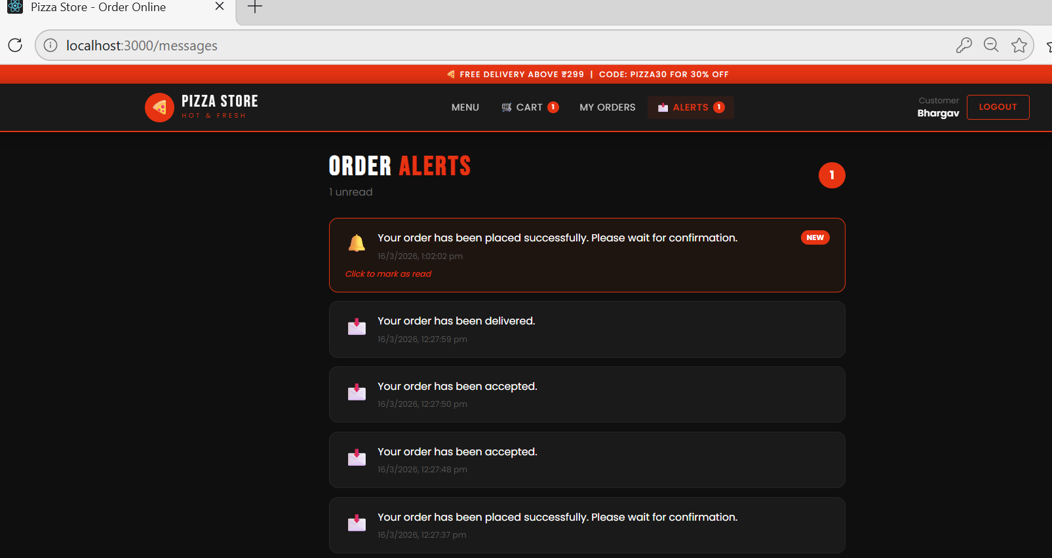
OVERVIEW OF APPLICATION
ORDER ALERTS PAGE :

Slide 9
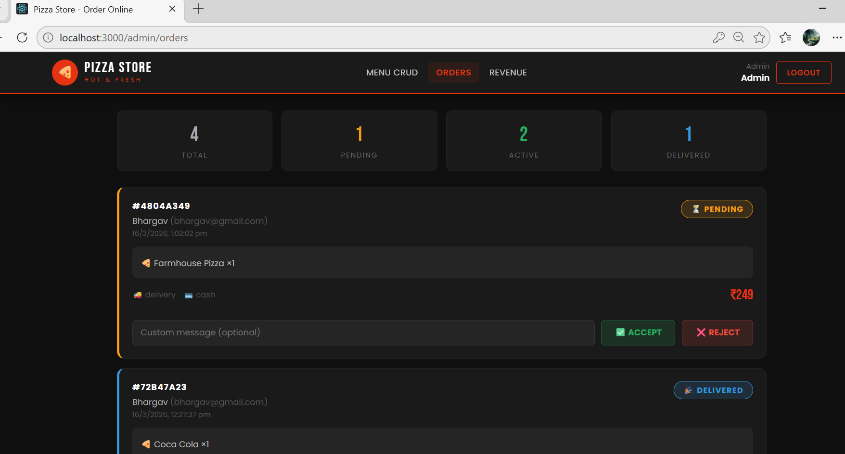
OVERVIEW OF APPLICATION
ADMIN DASHBOARD PAGE :

Slide 10
API ENDPOINTS & DATABASE DESIGN
REST API Endpoints
MongoDB Collections (8)
POST /api/auth/register – Customer registration
POST /api/auth/login – Login + JWT token
GET /api/menu – Fetch all menu items
POST /api/cart – Add item to cart
POST /api/orders – Place new order
PUT /api/orders/:id – Accept / Reject order (Admin)
GET /api/payments – Revenue data (Admin)
GET /api/messages – Order alert messages
users
Auth & profile data
categories
Pizza categories
menuitems
Menu items + prices
addresses
Delivery addresses
carts
Active cart items
orders
Order records
payments
Payment history
messages
Order alert messages

Slide 11
THANK YOU
✉ asabharga2004@gmail.com
🌐 http://localhost:3000
📋 Project ID: Pizza Store
📚 Batch: Wipro NGA -MERN-FY26

